Slide 1
Store Console App
JingJing Zhuang

Slide 2
Introduction
Purpose

Slide 3
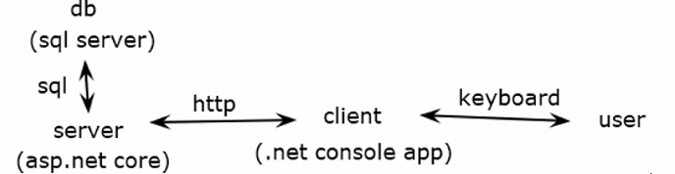
Tech Stack
Frameworks:
.NET Core, ASP.NET Core
Programming Languages:
C#, SQL
Database:
Azure SQL Server
Database Connection:
ADO.NET
Web Service API:
REST API
Service Hosting:
Azure App Service
Testing:
xUnit Test
Platforms:
Azure, Docker Desktop, Docker Hub, GitHub, Visual Studio, SonarCloud

Slide 4
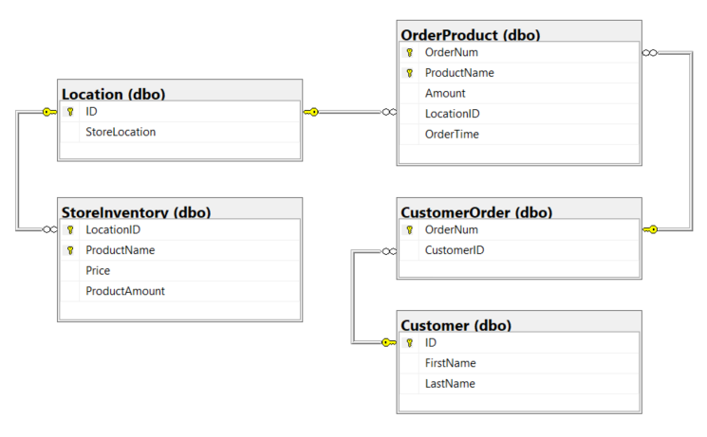
Database Diagram

Slide 5
CI/CD
Console App
CI pipeline to analyze with SonarCloud
CD pipeline to build, publish, and create a Docker image of my console app, and push it to my Docker Hub repo.
Web Service API
CI pipeline to analyze with SonarCloud
CD pipeline to build, publish, and deploy my API to Azure App Service for deployment.

